Slide 1
Ideal Living x Amazon
2025 Full Year Performance Overview
Brand vs Non-Brand | Ad-Driven vs Organic Analysis
Combining Sales Performance & Weekly Ad Spend Reports
Full Year 2025 (53 Weeks)
AMAZON SPONSORED ADS

Slide 2
2025 FULL YEAR PERFORMANCE
Overall Performance Summary
Metric | Value | Detail
Total Revenue (All Sources) | $3,193,483 | Across 10 brands
Total Units Sold | 52,865 | 47,782 orders
Ad-Driven Revenue | $991,694 | 31.1% of total
Organic Revenue | $2,201,141 | 68.9% of total
Total Ad Spend | $426,781 | TACoS: 13.4%
Overall ROAS | 2.32x | $2.32 ad rev per $1 spend
Sessions / Conversion | 240,967 / 19.8% | Avg 4,381/wk
Impressions | 44,708,551 | Avg 812,883/wk
Takeaways:
• Full year: $3,193,483 total revenue, 52,865 units across 55 weeks
• Organic revenue (68.9%) far exceeds ad-driven (31.1%) — strong brand equity
• ROAS of 2.32x at 13.4% TACoS — efficient ad investment
• Avg weekly revenue: $58,063

Slide 3
2025 BRAND vs NON-BRAND ANALYSIS
Brand vs Non-Brand — Total Ad Performance
Metric | Brand | Non-Brand | Total | % Brand
Ad Revenue | $759,591 | $201,549 | $961,139 | 79.0%
Ad Spend | $231,625 | $187,328 | $418,954 | 55.3%
Units Sold | 11,202 | 3,140 | 14,342 | 78.1%
ROAS | 3.28x | 1.08x | 2.29x | —
ACoS | 30.5% | 92.9% | 43.6% | —
CPO | $20.68 | $59.66 | $29.21 | —
Takeaways:
• Brand campaigns drive 79.0% of ad revenue on 55.3% of spend — highly efficient
• Brand ROAS (3.28x) is 3.0x higher than Non-Brand (1.08x)
• Non-Brand ACoS (92.9%) is unprofitable at aggregate level — needs optimization
• Brand spend is defensive (protecting existing customers), NB is offensive (acquiring new ones)

Slide 4
2025 BRAND vs NON-BRAND ANALYSIS
Brand vs Non-Brand — By Product
Product | B Rev | B Spend | B ROAS | B ACoS | NB Rev | NB Spend | NB ROAS | NB ACoS | % Brand Rev
Prosvent | $458,983 | $155,572 | 2.95x | 33.9% | $91,590 | $84,246 | 1.09x | 92.0% | 83.4%
Better Bladder | $134,490 | $29,885 | 4.50x | 22.2% | $60,422 | $50,207 | 1.20x | 83.1% | 69.0%
Ideal Prostate | $150,671 | $40,266 | 3.74x | 26.7% | $32,892 | $38,013 | 0.87x | 115.6% | 82.1%
GASF | $5,289 | $1,344 | 3.93x | 25.4% | $8,463 | $2,915 | 2.90x | 34.4% | 38.5%
Cebria | $3,402 | $3,009 | 1.13x | 88.5% | $4,356 | $3,795 | 1.15x | 87.1% | 43.9%
AromaTru | $4,248 | $807 | 5.26x | 19.0% | $2,617 | $4,673 | 0.56x | 178.6% | 61.9%
Profemin | $1,758 | $129 | 13.64x | 7.3% | $1,209 | $3,305 | 0.37x | 273.4% | 59.3%
BeFlexible | $690 | $601 | 1.15x | 87.1% | $0.00 | $144 | 0.00x | N/A | 100.0%
Perfect Omega | $59.90 | $12.64 | 4.74x | 21.1% | $0.00 | $31.25 | 0.00x | N/A | 100.0%
Takeaways:
• Prosvent: 83% brand revenue at 2.95x ROAS — strong brand loyalty drives returns
• Ideal Prostate: 82% brand with 3.74x ROAS — brand campaigns highly efficient
• GASF is unique: 62% non-brand revenue with strong 2.90x NB ROAS — category demand
• Profemin brand ROAS of 13.64x (tiny spend) vs NB 0.37x — NB campaigns need review

Slide 5
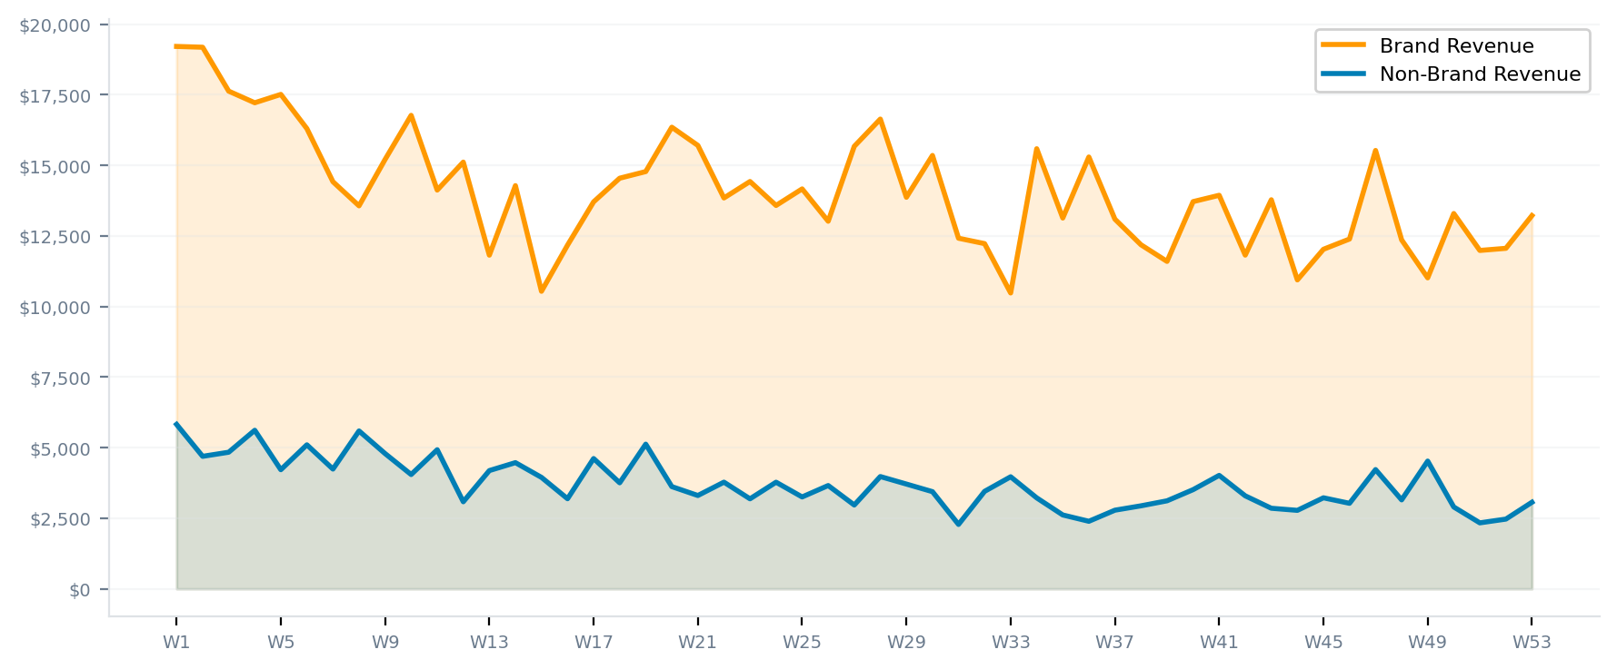
2025 BRAND vs NON-BRAND ANALYSIS
Weekly Trends — Brand vs Non-Brand Revenue
Takeaways:
• Brand revenue avg $14,052/wk vs Non-Brand avg $3,719/wk — 3.8x ratio
• Brand revenue declined from ~$19K/wk (Q1) to ~$12K/wk (Q4) — seasonal pattern
• Non-Brand revenue remained relatively flat ($3-5K/wk) throughout the year
• Gap between Brand and Non-Brand narrowed in Q4 as Brand seasonal demand softened

Slide 6
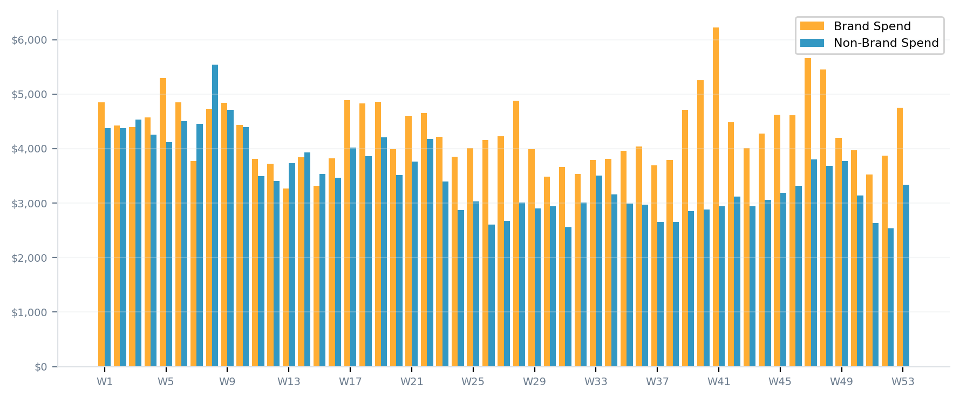
2025 BRAND vs NON-BRAND ANALYSIS
Weekly Trends — Brand vs Non-Brand Ad Spend
Takeaways:
• Brand spend: 55.3% of total ($231,625), NB: 44.7% ($187,328)
• Both Brand and NB spend remained relatively stable week-to-week
• Brand spend slightly increased in Q4 (W39-48) while returns decreased — watch efficiency
• NB spend consistent at $2.5-4.5K/wk — opportunity to optimize or reallocate

Slide 7
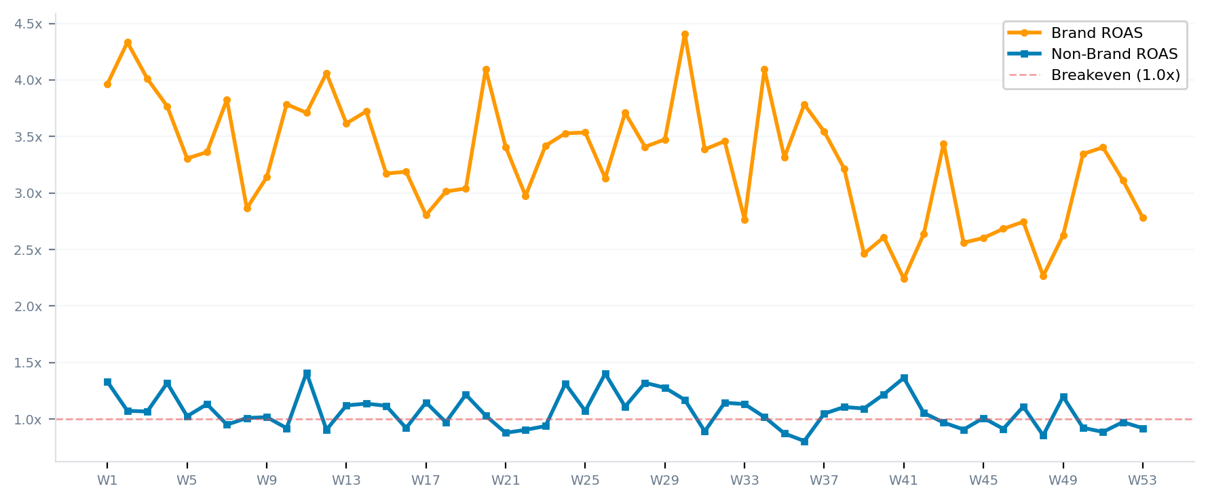
2025 BRAND vs NON-BRAND ANALYSIS
Weekly Trends — Brand vs Non-Brand ROAS
Takeaways:
• Brand ROAS avg 3.30x — consistently profitable, range 2.2x to 4.4x
• Non-Brand ROAS avg 1.07x — hovering near breakeven, frequently below 1.0x
• Brand ROAS declined from ~4.0x (Q1) to ~2.5x (Q4) — still profitable but declining
• Non-Brand rarely exceeds 1.4x — structural challenge requiring keyword optimization

Slide 8
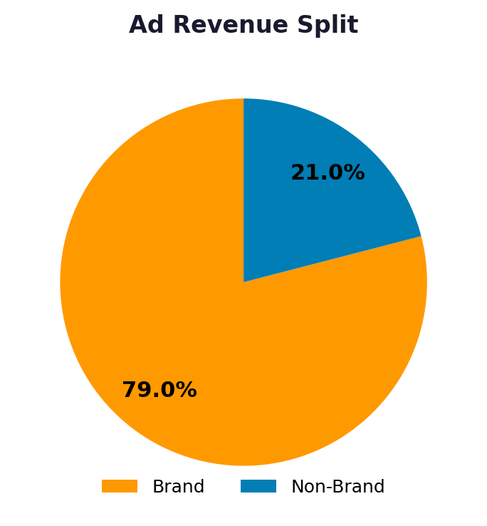
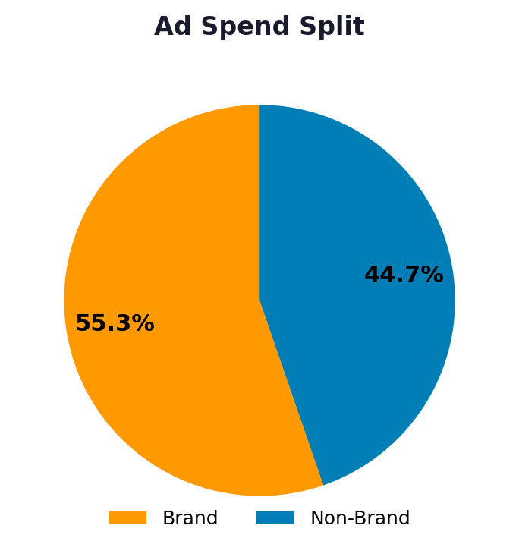
2025 BRAND vs NON-BRAND ANALYSIS
Revenue & Spend Split — Brand vs Non-Brand
Takeaways:
• Brand captures 79.0% of ad revenue using 55.3% of spend — 3x efficiency advantage
• Non-Brand consumes 44.7% of spend but generates only 21.0% of revenue
• Rebalancing even 10% of NB spend to Brand could yield significant ROI improvement
• However, NB campaigns serve a customer acquisition role beyond immediate ROAS

Slide 9
2025 FULL YEAR PERFORMANCE
Performance by Brand — Total Sales
Brand | Revenue | Units | Ad Spend | Ad Sales | Organic | % Organic | ROAS | TACoS
Prosvent | $1,777,284 | 29,956 | $244,591 | $565,908 | $1,211,376 | 68.2% | 2.31x | 13.8%
Better Bladder | $658,094 | 9,956 | $80,854 | $200,815 | $457,279 | 69.5% | 2.48x | 12.3%
Ideal Prostate | $600,771 | 9,369 | $80,198 | $192,396 | $408,375 | 68.0% | 2.40x | 13.3%
Cebria | $53,253 | 1,451 | $6,868 | $8,526 | $44,727 | 84.0% | 1.24x | 12.9%
Grown American | $44,158 | 1,052 | $4,222 | $12,983 | $31,105 | 70.4% | 3.08x | 9.6%
Profemin | $28,904 | 528 | $3,609 | $3,187 | $25,717 | 89.0% | 0.88x | 12.5%
BeFlexible | $17,597 | 252 | $687 | $690 | $16,418 | 93.3% | 1.00x | 3.9%
AromaTru | $12,614 | 274 | $5,709 | $7,129 | $5,396 | 42.8% | 1.25x | 45.3%
Perfect Omega | $809 | 27 | $43.89 | $59.90 | $749 | 92.6% | 1.36x | 5.4%
Takeaways:
• Total portfolio: $3,193,483 revenue — 68.9% organic, 31.1% ad-driven
• Prosvent dominates at $1,777,284 (55.7%)
• Ad spend data ($418,954) reconciles with performance report ($426,781)
• Strong organic base across all major brands reduces dependency on paid channels

Slide 10
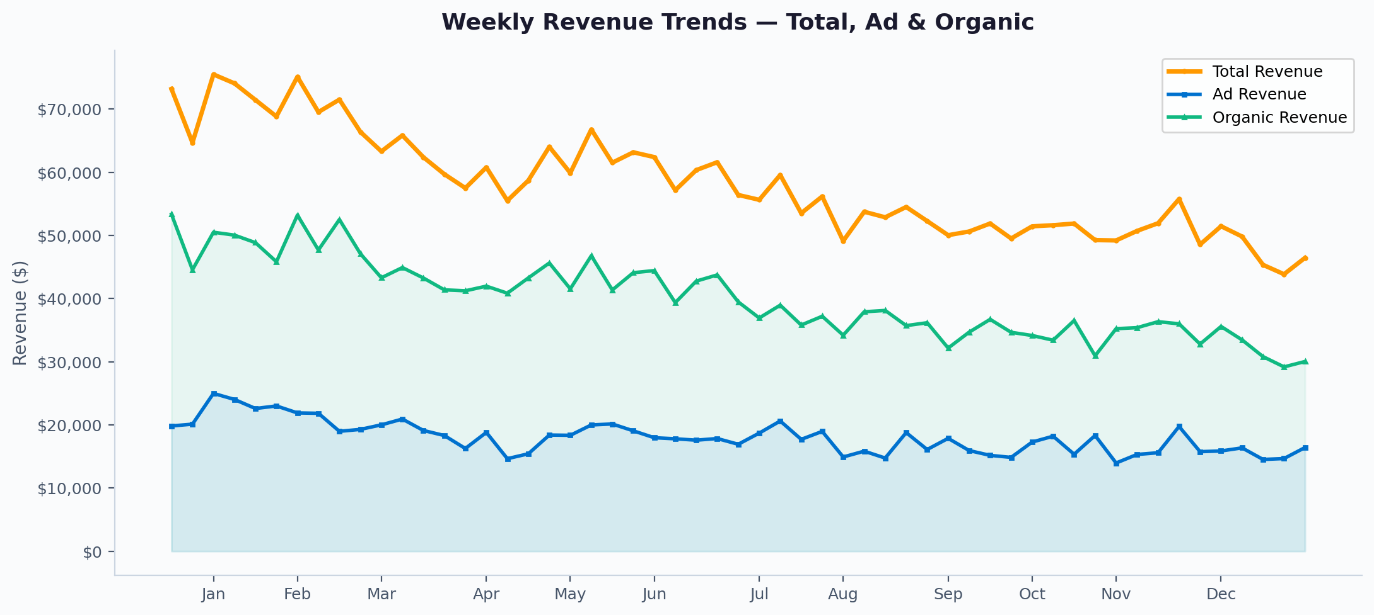
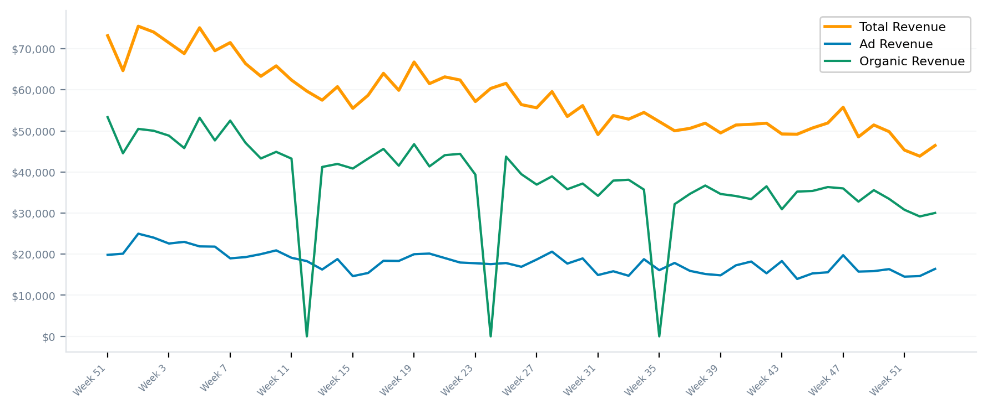
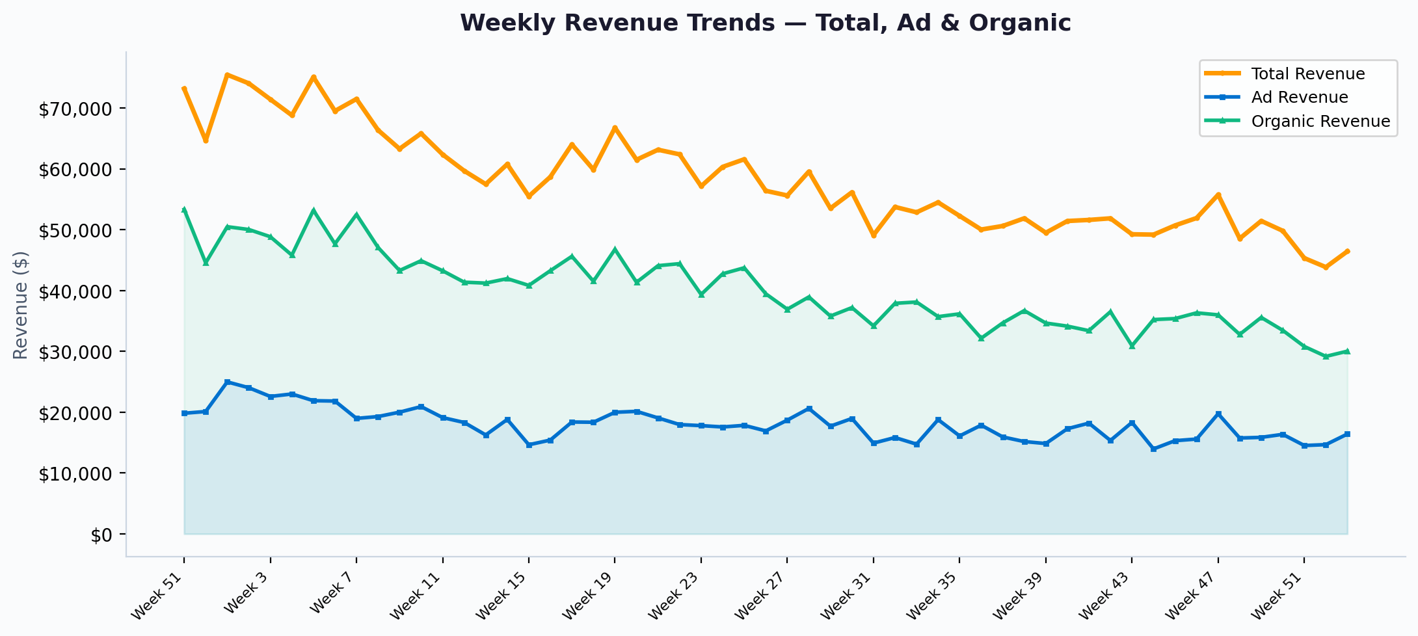
2025 FULL YEAR PERFORMANCE
Weekly Revenue Trends — Total, Ad & Organic
Takeaways:
• Revenue declined ~30% from Q1 to Q4 — consistent seasonal pattern
• Organic revenue tracked total revenue decline, not just ad-driven
• Ad revenue remained more stable as a percentage of total
• Revenue floor appears around $45-50K/wk in lowest weeks

Slide 11
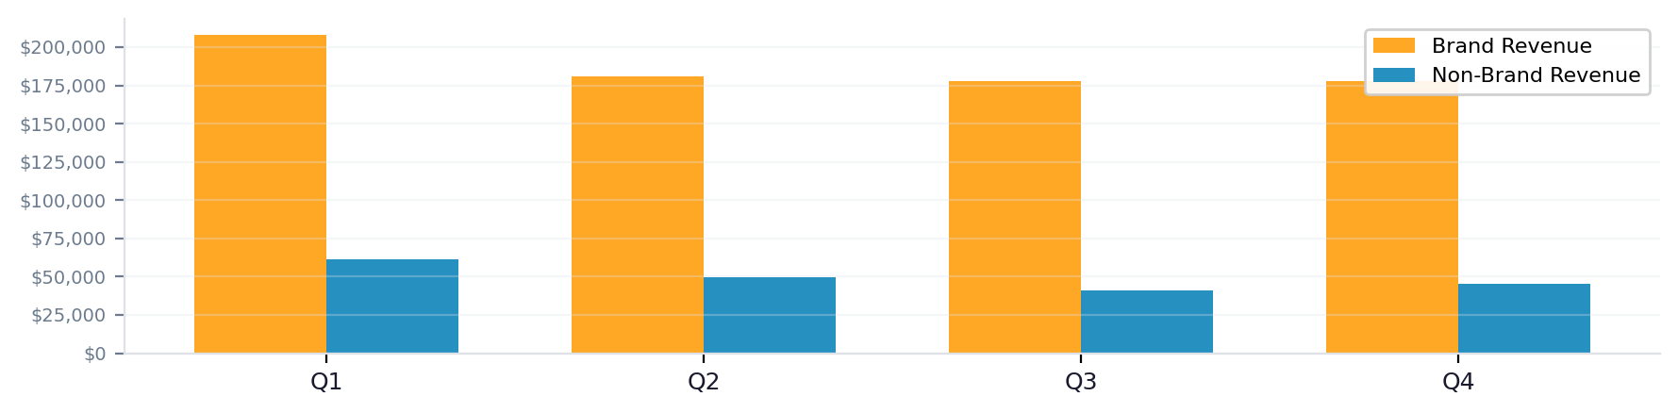
2025 FULL YEAR PERFORMANCE
Quarterly Brand vs Non-Brand Comparison
Quarter | B Rev | B Spend | B ROAS | NB Rev | NB Spend | NB ROAS | Total Rev | % Brand
Q1 | $208,056 | $56,952 | 3.65x | $61,160 | $55,878 | 1.09x | $269,216 | 77.3%
Q2 | $181,101 | $55,030 | 3.29x | $49,681 | $46,370 | 1.07x | $230,782 | 78.5%
Q3 | $177,537 | $51,570 | 3.44x | $40,871 | $37,880 | 1.08x | $218,409 | 81.3%
Q4 | $178,061 | $64,892 | 2.74x | $45,382 | $44,348 | 1.02x | $223,443 | 79.7%
Takeaways:
• Brand ROAS declined from Q1 (3.65x) to Q4 (2.74x)
• Non-Brand ROAS stayed near breakeven (~1.0-1.1x) across all quarters
• Q1 Brand revenue was 32% higher than Q4 — seasonal demand decline
• Non-Brand revenue remarkably stable across quarters (~$13-14K/quarter)

Slide 12
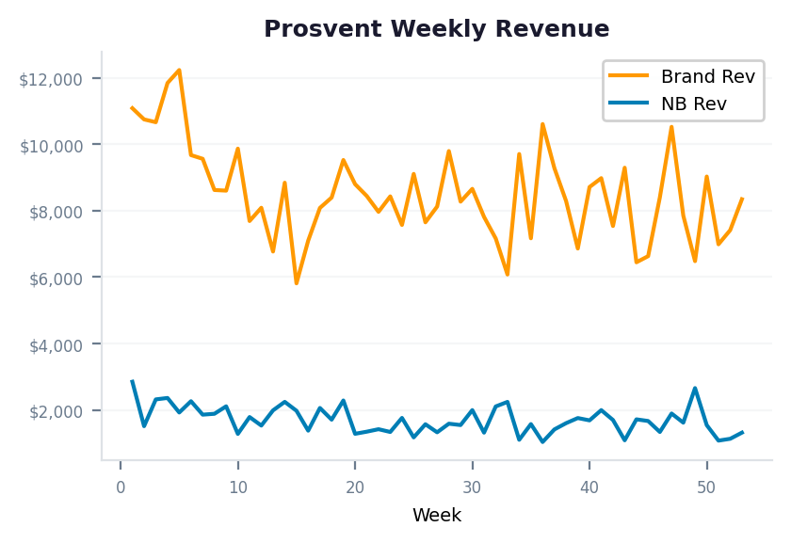
2025 BRAND DEEP DIVE
Prosvent — Brand vs Non-Brand Analysis
Metric | Brand | Non-Brand | Total
Revenue | $458,983 | $91,590 | $550,573
Ad Spend | $155,572 | $84,246 | $239,817
Units | 6,906 | 1,449 | 8,355
ROAS | 2.95x | 1.09x | 2.30x
ACoS | 33.9% | 92.0% | 43.6%
CPO | $22.53 | $58.14 | —
% of Revenue | 83.4% | 16.6% | 100%
Takeaways:
• Brand campaigns generate 83.4% of revenue at 2.95x ROAS — core strength
• Non-Brand ACoS of 92.0% is unprofitable — review NB keyword portfolio
• Brand CPO ($22.53) is well below breakeven threshold
• Consider shifting 15-20% of NB budget to Brand for immediate ROI improvement

Slide 13
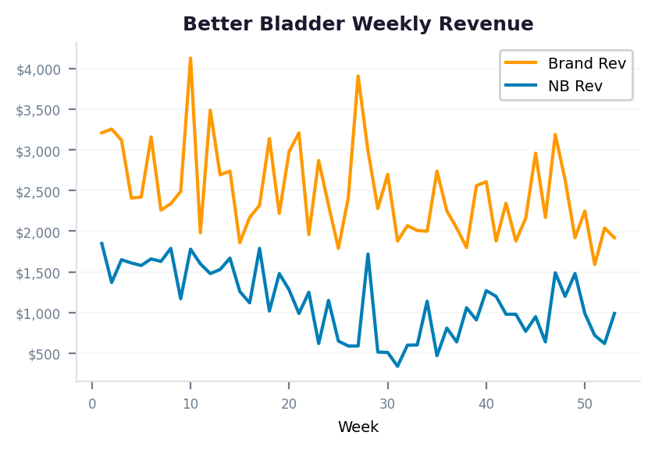
2025 BRAND DEEP DIVE
Better Bladder — Brand vs Non-Brand Analysis
Metric | Brand | Non-Brand | Total
Revenue | $134,490 | $60,422 | $194,912
Ad Spend | $29,885 | $50,207 | $80,092
Units | 1,886 | 866 | 2,752
ROAS | 4.50x | 1.20x | 2.43x
ACoS | 22.2% | 83.1% | 41.1%
CPO | $15.85 | $57.98 | —
% of Revenue | 69.0% | 31.0% | 100%
Takeaways:
• Brand ROAS of 4.50x is the highest among top-3 products
• Non-Brand drives 31.0% of revenue but at 83.1% ACoS — near breakeven
• Strong candidate for NB keyword optimization — some terms likely profitable
• Test increasing Brand bid aggressiveness during peak conversion hours

Slide 14
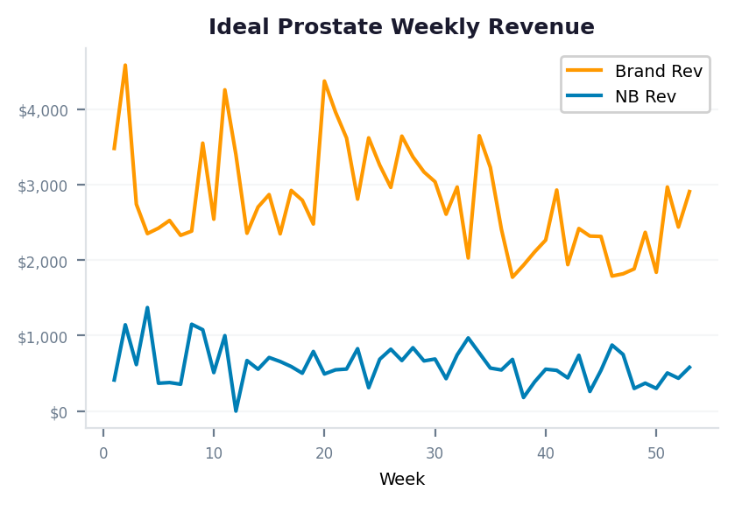
2025 BRAND DEEP DIVE
Ideal Prostate — Brand vs Non-Brand Analysis
Metric | Brand | Non-Brand | Total
Revenue | $150,671 | $32,892 | $183,563
Ad Spend | $40,266 | $38,013 | $78,278
Units | 2,122 | 462 | 2,584
ROAS | 3.74x | 0.87x | 2.35x
ACoS | 26.7% | 115.6% | 42.6%
CPO | $18.98 | $82.28 | —
% of Revenue | 82.1% | 17.9% | 100%
Takeaways:
• Highest Brand revenue concentration (82.1%) among top products
• Non-Brand ROAS of 0.87x is below breakeven — NB campaigns losing money
• Cross-sell opportunity: target Prosvent buyers with Ideal Prostate ads
• Focus NB spend on top-converting generic terms only

Slide 15
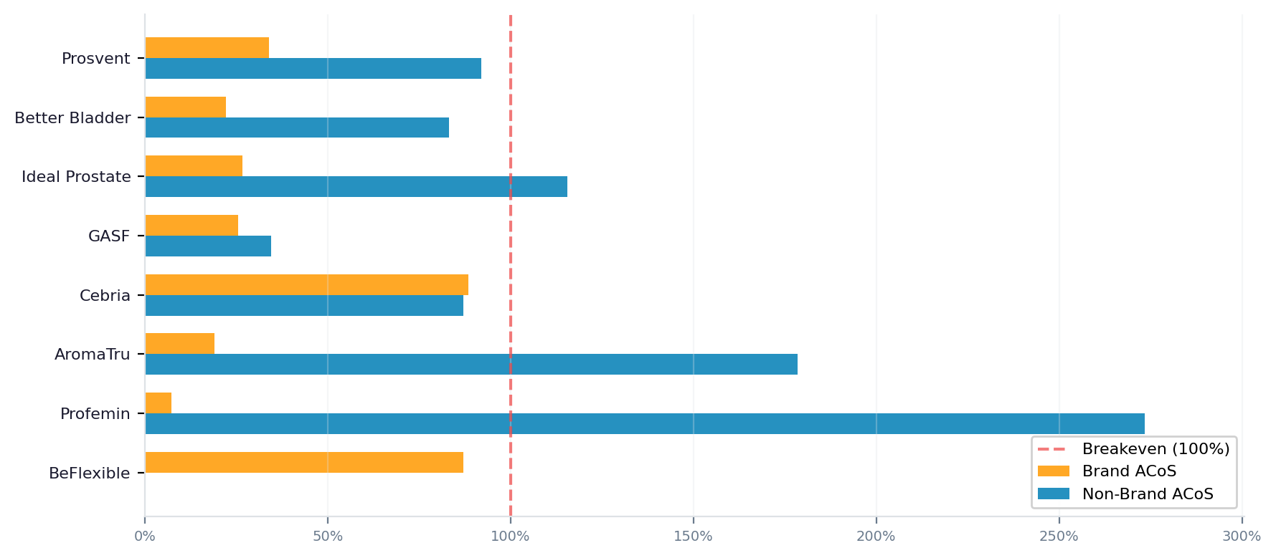
2025 BRAND vs NON-BRAND ANALYSIS
ACoS Analysis — Brand vs Non-Brand by Product
Takeaways:
• Brand ACoS is below breakeven (100%) for all products — profitable across the board
• Non-Brand ACoS exceeds breakeven for Ideal Prostate (116%), Profemin, and AromaTru
• Prosvent NB ACoS of 92% is near breakeven — some NB keywords likely profitable, others not
• GASF is the standout: both Brand (25%) and NB (34%) ACoS well below breakeven

Slide 16
2025 FULL YEAR
2026 Strategic Recommendations
▸ Protect Brand Revenue — It's Your Profit Engine
Brand campaigns generate 79.0% of ad revenue at 3.3x ROAS. Maintain and grow branded keyword coverage. Any competitor conquesting your brand terms will directly erode this high-margin revenue.
▸ Aggressively Optimize Non-Brand Campaigns
Non-Brand ACoS of 92.9% is unsustainable. Audit search term reports weekly, pause non-converting terms, and focus NB spend on proven category keywords. Target <60% ACoS for NB campaigns.
▸ Reallocate Budget: Shift NB→Brand Where Possible
Moving 15-20% of NB budget ($28,099-$37,466) to Brand could generate an additional $92,149-$122,865 in revenue at current Brand ROAS.
▸ Address Q1→Q4 Revenue Decline
Revenue dropped ~30% through the year. Deploy seasonal promotions, Subscribe & Save pushes, and targeted deal events in Q3/Q4 to counter natural demand softening.
▸ Scale GASF Non-Brand — Unique Opportunity
GASF is the only product with strong NB ROAS (2.9x). Increase NB spend for GASF to capture more category demand profitably.
▸ Invest in Organic Growth to Reduce Ad Dependency
Organic revenue (68.9%) is the foundation. Invest in A+ Content, review generation, and Subscribe & Save to grow organic and further reduce TACoS.

Slide 17
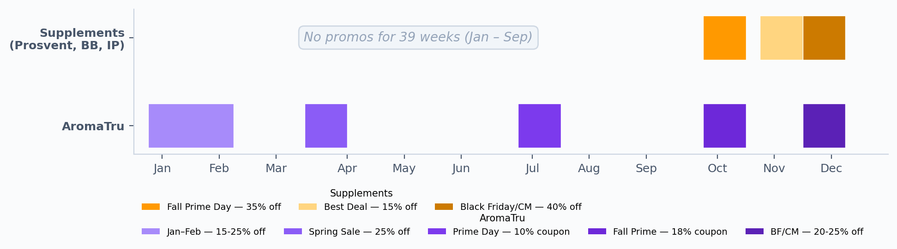
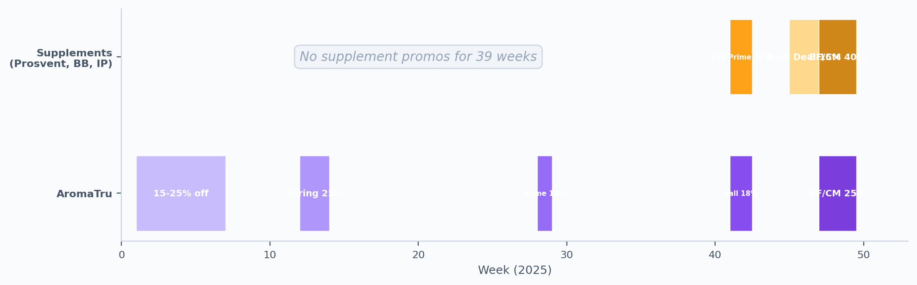
PROMOTIONS & COUPONS
2025 Promotional Calendar Overview
39 Weeks
3 Promo Windows
40% Max Discount
with zero supplement promotions (Jan–Sep)
all concentrated in Q4 (Oct–Dec only)
during Black Friday / Cyber Monday week
Supplement brands missed 39 weeks of potential promotional lift — consider spreading promos across 2026
AromaTru ran 5 promo windows year-round — a model worth applying to supplement brands

Slide 18
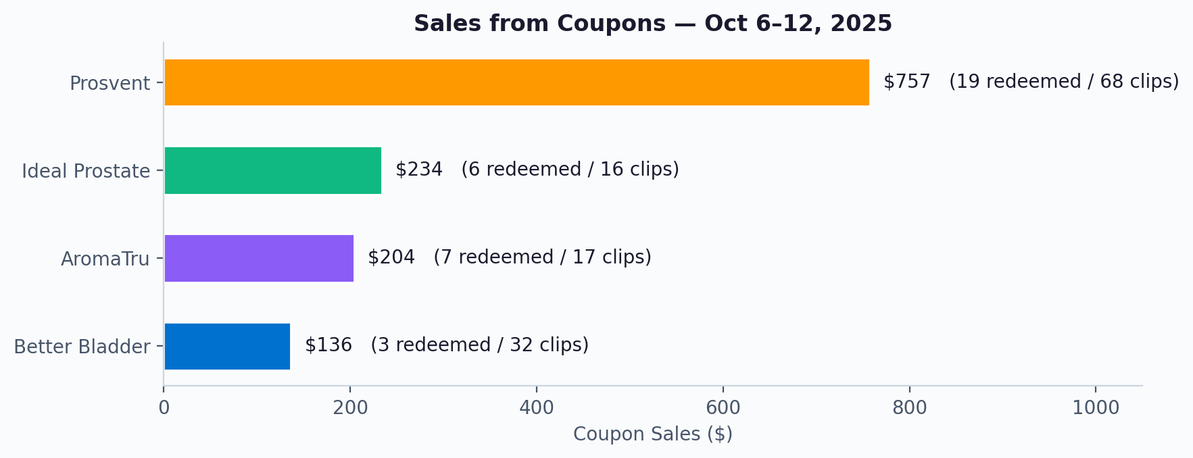
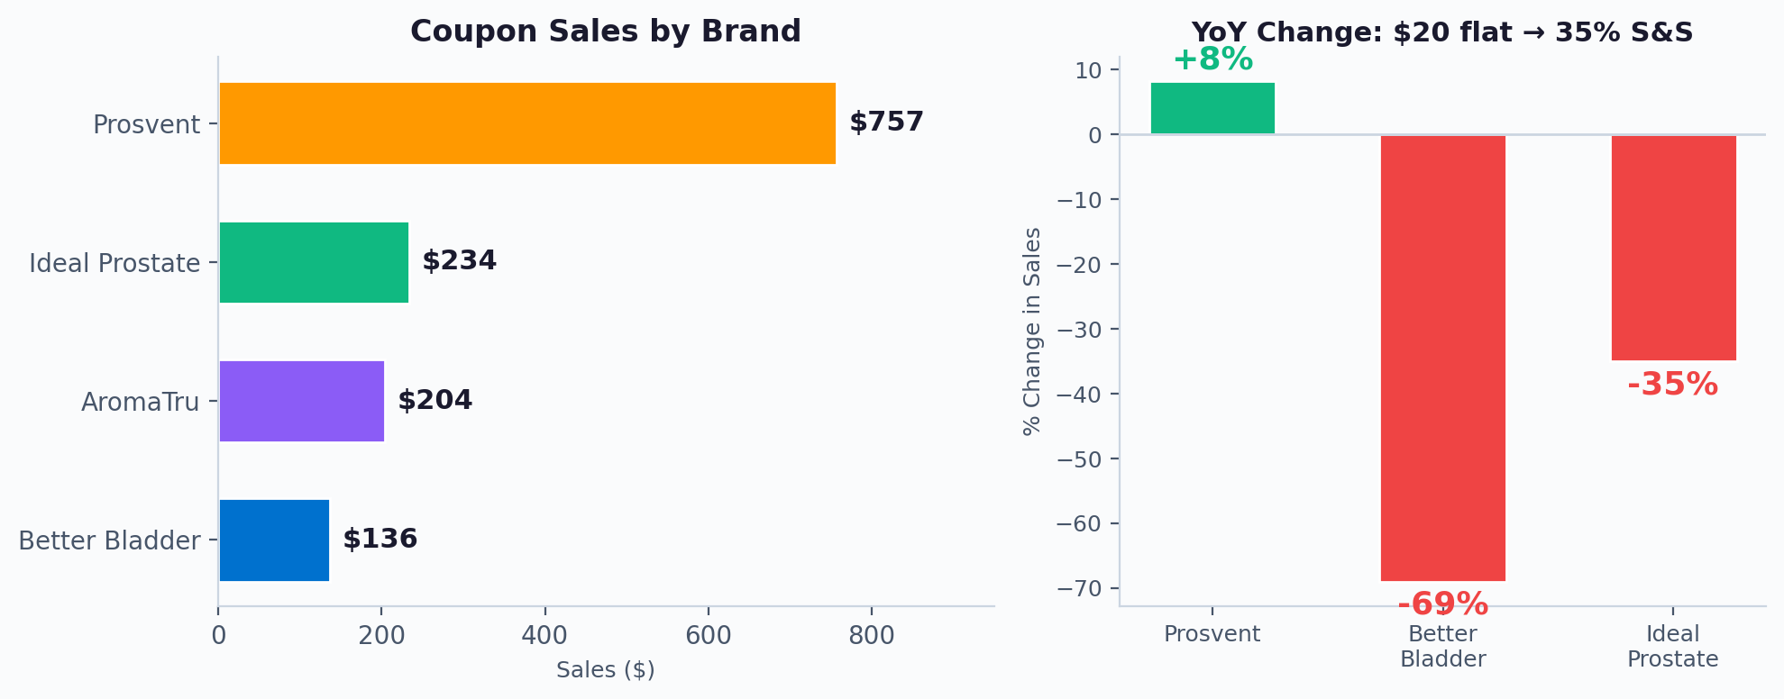
PROMOTIONS & COUPONS
Coupon Performance — Fall 2025 Prime Day
$1,331
2.07x
$643
Total Coupon Sales
Return on Budget
Total Budget Spent
Prosvent drove 57% of all coupon sales — strongest brand loyalty and coupon engagement
AromaTru's first-ever coupon delivered $204 on just $36 budget — strongest ROI in portfolio (5.7x)
Opportunity to scale coupon programs with larger budgets and broader product coverage in 2026

Slide 19
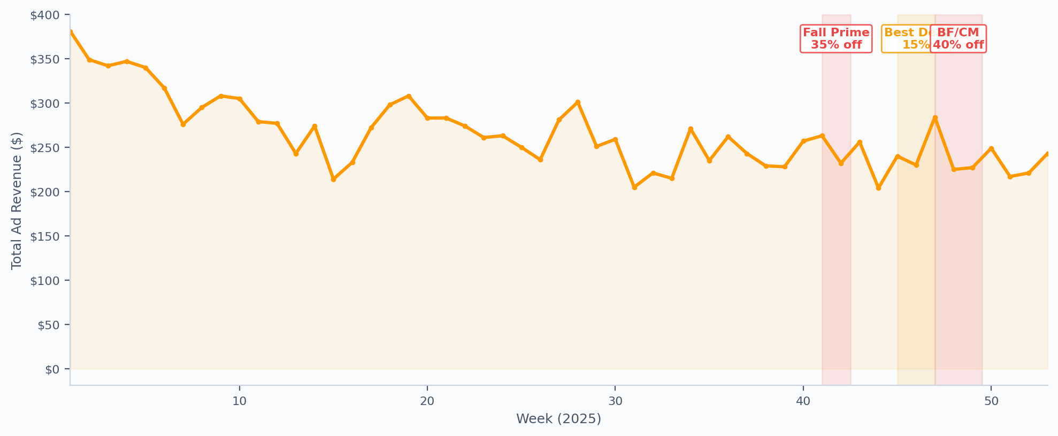
PROMOTIONS & COUPONS
Promo Windows vs Weekly Ad Revenue
Q4 promos didn't reverse the natural seasonal revenue decline — ad revenue still fell despite 35–40% discounts
H1 generated higher revenue with zero promotions — organic demand was stronger in the first half
Promo-driven lift was modest; the bigger opportunity is spreading promotions into H1 to sustain momentum

Slide 20
PROMOTIONS & COUPONS
2026 Promotional Recommendations
Spread Promos Across the Year
39 weeks without promotions is a missed opportunity. Run 15–20% coupons during Big Spring Sale, Memorial Day, and Summer Prime to sustain revenue in H1.
Revert Better Bladder to Flat Dollar-Off
The 35% S&S coupon caused a -69% sales drop. Better Bladder's $40–$60 price point responds better to tangible "Save $15" offers than percentage discounts.
Scale AromaTru Coupon Campaigns
AromaTru's first coupon delivered 5.7x ROI on minimal spend. Increase budget and run coupons alongside its existing year-round promotional cadence.
Avoid Deep Discount Stacking in Q4
Running 35% → 15% → 40% in rapid succession may train shoppers to wait for the deepest cut. Consider a steadier 20–25% discount throughout Q4 instead.

